Slide 1

Objectives
In this session, you will learn to:
  Describe the Java EE job roles involved in web application development
  Design a web application using custom tags
  Use JavaServer Pages Tag Library (JSTL) tags in a JSP Page
Notes:
Start the session by explaining the objectives listed in Slide 1. Using custom tag libraries, you can eliminate most (if not all) scripting elements from JSP pages. Custom tags are also reusable components. If you use common scriptlet code in multiple JSP pages, you must cut-and-paste to keep the code identical. This is a maintenance problem if you need to change all of the scriptlet code in all of the pages that use it. Alternatively, you can have a custom tag that encapsulates the scriptlet code. In which case, changing the tag handler changes the behavior of the tag across all uses of that tag in all JSP pages.
The end of this module reviews all the tags available in JSTL.
Use the following flow for this module:
● Understand the job roles involved in web application development
● Understand the rationale in using custom tags
● Develop a JSP page using an existing custom tag library
Exercise 1: Refactor the ListLibrary JSP page using JSTL
Exercise 2: Refactor the AddDVDForm JSP page using JSTL

Slide 2
The Java EE Job Roles Involved in Web Application Development
Job roles for a large web application might include:
  Web Designers: Responsible for creating the views of the application, which are primarily composed of HTML pages
  Web Component Developers: Responsible for creating the control elements of the application, which is almost exclusively Java technology code
  Business Component Developers: Responsible for creating the model elements of the application, which might reside on the web server or on a remote server (such as an EJB technology server)
Notes:
Use this slide to explain about the Java EE Job Roles Involved in Web Application Development.

Slide 3
Contrasting Custom Tags and Scriptlet Code
42 <%-- Report any errors (if any) --%>
43 <%
44 // Retrieve the errorMsgs from the request-scope
45 List errorMsgs = (List)
request.getAttribute(“errorMsgs”);
46 if ( (errorMsgs != null) && !errorMsgs.isEmpty() ) {
47 %>
48 <p>
49 <font color=’red’>Please correct the following errors:
50 <ul>
51 <%
52 Iterator items = errorMsgs.iterator();
53 while ( items.hasNext() ) {
54 String message = (String) items.next();
55 %>
56 <li><%= message %></li>
57 <%
58 } // END of while loop over errorMsgs
59 %>
60 </ul>
61 </font>
62 </p>
63 <%
64 } // END of if errorMsgs is not empty
65 %>
Notes:
Use Slides 3, 4, and 5 to explain about contrasting custom tags and scriptlet code. The code given in the slide shows the scripting code used to display error messages.

Slide 4
Contrasting Custom Tags and Scriptlet Code (Contd.)
Equivalent custom tag in the registration form:
  40 <%-- Report any errors (if any) --%>
  41 <c:if test=”${not empty errorMsgs}”>
  42 <p>
  43 <font color=’red’>Please correct the following
  errors:
  44 <ul>
  45 <c:forEach var=”message” items=”${errorMsgs}”>
  46 <li>${message}</li>
  47 </c:forEach>
  48 </ul>
  49 </font>
  50 </p>
  51 </c:if>

Slide 5
Contrasting Custom Tags and Scriptlet Code (Contd.)
Advantages of custom tags compared to scriptlet code:
  Java technology code is removed from the JSP page.
  Custom tags are reusable components.
  Standard job roles are supported.

Slide 6
Developing JSP Pages Using Custom Tags
Use a custom tag library description
Understand that custom tags follow the XML tag rules
Declare the tag library in the JSP page and in the web application deployment descriptor
Notes:
Use this slide to explain about developing JSP pages by using custom tags. Custom tags simplify the development and maintenance of the JSP page. Custom tags can be used to perform dynamic tasks such as, operating on implicit objects, processing forms, and accessing databases. Custom tags are distributed in a tag library.

Slide 7
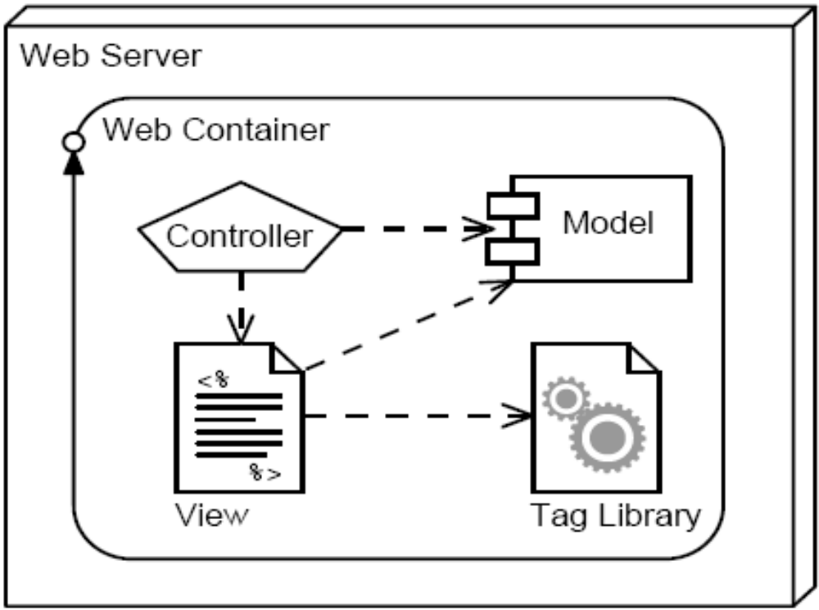
Custom Tag Library Overview
A custom tag library is a web component that contains a tag library descriptor file and all associated tag handler classes:
Notes:
Use Slides 7 and 8 to explain about the custom tag library. A custom tag library is a collection of custom actions presented as tags. It helps write code that provides data access and other services, and it make those features available in a simple to use XML-like fashion. For example, you can use a custom tag in a JSP page to gain database access. For this, you do not have to understand the underlying details to complete the action of database access.

Slide 8
Custom Tag Library Overview (Contd.)
Custom tag handlers used in a JSP page can access any object that is also accessible to the JSP page.
This is accomplished by the pageContext object that is unique for a given JSP page and for a given request on that JSP page.
The pageContext object provides access to all attribute scopes: page, request, session, and application.
The pageContext object provides access to all implicit objects in the JSP page (request, response, out, and so on).

Slide 9
Custom Tag Syntax Rules
Custom tags use XML syntax.
  Standard tags (containing a body):
    <prefix:name {attribute={”value”|’value’}}*>
    body
    </prefix:name>
  Empty tags:
    <prefix:name {attribute={”value”|’value’}}* />
  Tag names, attributes, and prefixes are case sensitive.
  Tags must follow nesting rules:
    <tag1>
    <tag2>
    </tag2>
    </tag1>
Notes:
Use this slide to explain about the custom tag syntax rules.

Slide 10
JSTL Sample Tags
This section presents a few of the tags from the core tag library in JSTL:
  set
  if
  forEach
  url
  out
Notes:
Use this slide to explain about the JSTL sample tags. The Core library contains actions for everyday tasks, such as importing the content of a URL resource, looping over a collection of objects, manipulating URLs for session tracking, and redirecting the response to a different URL.

Slide 11
The set Tag
You use the set tag to store a variable in a named scope or to update the property of a JavaBeans instance or Map.
  Body content: Empty if the value attribute is supplied. Otherwise, the body is the value.
  The var attribute: This mandatory attribute is the name of the request parameter.
  The value attribute: This optional attribute is an empty tag and provides the value for the variable.
  The scope attribute: This optional attribute supplies the scope location of the variable.
Notes:
Use Slides 11 and 12 to explain about the set tag.

Slide 12
The set Tag (Contd.)
The following example shows how to use the JSTL set tag:
  4
  5 <%-- Set page title --%>
  6 <c:set var=”pageTitle”>Duke’s Soccer League:
  Registration</c:set>
  7
  8 <%-- Generate the HTML response --%>
  9 <html>
  10 <head>
  11 <title>${pageTitle}</title>
  12 </head>

Slide 13
The if Tag
The if tag is a conditional tag in JSTL. A test expression is evaluated and the results of the test can be stored for later use. If a body is supplied, the body is only evaluated if the test results in true.
  Body content: Optional. If present, only evaluated if test expression is true.
  The test attribute: This mandatory attribute contains the expression to be evaluated.
  The var attribute: This optional attribute is used to store the result of the test.
  The scope attribute: This optional attribute supplies the scope location of the var attribute.
Notes:
Use Slides 13 and 14 to explain about the if tag.

Slide 14
The if Tag (Contd.)
The following example shows how to use the JSTL if tag:
  39
  40 <%-- Report any errors (if any) --%>
  41 <c:if test=”${not empty errorMsgs}”>
  42 <p>
  43 <font color=’red’>Please correct the
  following errors:
  44 <ul>
  45 <c:forEach var=”message”
  items=”${errorMsgs}”>
  46 <li>${message}</li>
  47 </c:forEach>
  48 </ul>
  49 </font>
  50 </p>
  51 </c:if>

Slide 15
The forEach Tag
The forEach tag provides iteration capabilities over a body. If a collection is supplied, it can be a java.util.Collection, java.util.Map, java.util.Iterator, java.util.Enumeration, array, or comma-delimited string.
  Body content: Contains what will be iterated over.
  The items attribute: This optional attribute specifies the collection to be iterated over.
  The var attribute: This optional attribute stores the current item in the iteration.
  The varStatus attribute: This optional attribute stores information about the step of the iteration.
Notes:
Use Slides 15, 16 and 17 to explain about the forEach tag.

Slide 16
The forEach Tag (Contd.)
Additional JSTL forEach tag attributes:
  The begin attribute: This attribute specifies the first element in the iteration. If the items attribute is not specified, the begin attribute is required.
  The end attribute: This attribute specifies the last element in the iteration. If the items attribute is not specified, the end attribute is required.
  The step attribute: This optional attribute specifies that the iteration should only include every nth item.

Slide 17
The forEach Tag (Contd.)
The following example shows how to use the JSTL forEach tag:
  43 <font color=’red’>Please correct the
  following errors:
  44 <ul>
  45 <c:forEach var=”message”
  items=”${errorMsgs}”>
  46 <li>${message}</li>
  47 </c:forEach>
  48 </ul>
  49 </font>

Slide 18
The url Tag
You use the url tag to provide a URL with appropriate rewriting for session management. The rewritten URL is typically written to the output stream, but can be stored in a scoped variable for later use.
  The value attribute: This mandatory attribute specifies the URL to be rewritten.
  The var attribute: This optional attribute is used to store the rewritten URL.
  The scope attribute: This optional attribute is used to specify the storage location of the variable.
Notes:
Use Slides 18 and 19 to explain about the url tag.

Slide 19
The url Tag (Contd.)
The following example shows how to use the JSTL url tag:
  52
  53 <%-- Present the form --%>
  54 <form action=’<c:url
  value=”enter_player.do” />’ method=’POST’>
The value attribute can also be used with absolute paths (relative to the web application’s context root):
  <form action=’<c:url value=”/register/enter_player.do” />’
  method=’POST’>
  ...
  </form>

Slide 20
The out Tag
The out tag is used to evaluate an expression and write the result to the current JSPWriter.
  Body content: The body content can contain the default result.
  The value attribute: This attribute specifies the expression to be evaluated.
  The default attribute: This optional attribute specifies a result to use if the expression evaluates to null.
  The escapeXml attribute: This optional attribute indicates whether or not the characters (<), (>), (&), (‘), and (“) should be replaced (default is true).
Notes:
Use Slides 20 and 21 to explain about the out tag. The <c:out> tag is similar to JSP expressions such as <%= scripting-language-expression %> or ${el-expression}. For example,
You have <c:out value="${sessionScope.item.count}"/> items.

Slide 21
The out Tag (Contd.)
The following example shows how to use the out tag:
  <c:out value=”${param.email}” default=”no email provided” />
When displaying content provided by the user, it is best to set the escapeXml attribute to true to prevent cross-site attacks:
  <p>
  <b>Comments:</b> </br>
  <c:out value=”${user.comments}”
  escapeXml=”true” />
  </p>

Slide 22
Using a Custom Tag Library in JSP Pages
The symbolic URI is used in the taglib directive in the JSP page to identify which tag library is being used and which prefix to use for those custom tags.
  2 <%@ taglib prefix=”c”
  uri=”http://java.sun.com/jsp/jstl/core” %>
  3 <%@ taglib prefix=”forms”
  uri=”http://www.soccer.org/forms.tld” %>
Any number of tag libraries might be included in a JSP page, but each must have a unique prefix.
Use the taglib element in the deployment descriptor to declare that the web application makes use of a tag library.
  149 <taglib>
  150 <taglib-uri>http://www.soccer.org/
  forms.tld</taglib-uri>
  151 <taglib-location>/WEB-INF/
  forms.tld</taglib-location>
  152 </taglib>
Notes:
Use this slide to explain about using the custom tag library in JSP page. JSP tag libraries are defined in a tag library descriptor(tld) file. To use a custom tag library from a JSP page, you need to reference its tld with a <%@ taglib %> directive. The syntax of taglib directive is:
<%@ taglib uri = "tag library URI" prefix = "tag Prefix" %>
where, uri uniquely identifies the tag library descriptor and prefix is a string that will become the prefix to distinguish a custom action.
For example:
<%@ taglib uri="sampleTLD" prefix=“tb" %>

Slide 23
Using an Empty Custom Tag
An empty tag is often used to embed simple dynamic content. The following code shows that the set tag stores the variable errors in the page scope.
  53 <%-- Present the form --%>
  54 <form action=’<c:url value=”enter_player.do”
  />’ method=’POST’>
Note that the slash (/) is at the end of the tag.
Notes:
Use this slide to explain about using an empty custom tag.

Slide 24
Using a Conditional Custom Tag
Partial scriptlet code in the error page:
  <%
  if ( errors != null) {
  %>
  <%-- “error messages” JSP code --%>
  <%
  } // end of IF
  %>
Equivalent custom tag in the error page:
  <c:if test=”${not empty errorMsgs}”>
  <%-- “error messages” JSP code --%>
  </c:if>
Notes:
Use this slide to explain about using a conditional custom tag.

Slide 25
Using an Iterative Custom Tag
26
27 <%
28 // Retrieve the set of leagues the LeagueService
29 LeagueService leagueSvc = new LeagueService();
30 List leagueList = leagueSvc.getAllLeagues();
31 %>
32 <%-- Generate main body --%>
33 <p>
34 The set of soccer leagues are:
35 </p>
36 <ul>
37 <%
38 Iterator items = leagueList.iterator();
39 while ( items.hasNext() ) {
40 League league = (League) items.next();
41 %>
42 <li><%= league.getTitle() %></li>
43 <% } %>
44 </ul>
Notes:
Use Slides 25 and 26 to explain about using an iterative custom tag.

Slide 26
Using an Iterative Custom Tag (Contd.)
21
22 <%-- Retrieve the set of leagues the LeagueService --%>
23 <jsp:useBean id=”leagueSvc” scope=”page”
24 class=”sl314.model.LeagueService” />
25
26 <%-- Generate main body --%>
27 <p>
28 The set of soccer leagues are:
29 </p>
30
31 <ul>
32 <c:forEach var=”league” items=”${leagueSvc.allLeagues}” >
33 <li>${league.title}</li>
34 </c:forEach>
35 </ul>

Slide 27
Demo: Developing JSP Pages Using Custom Tags
Demo: Developing JSP Pages Using Custom Tags
Notes:
In this demo, you demonstrate the use of filters in a Web application. You can run the project, JSPTagDemo, stored at Datafiles For Faculty\Session17\Demo1\mod12_jsp_tags.zip file in the TIRM CD for demonstration.

Slide 28
Summary
In this session, you learned:
  Custom tags are fundamentally the same as standard tags, but you can acquire tag libraries from third parties and even build your own application-specific tags.
  The JSP Standard Tag Library (JSTL) provides a collection of general-purpose tags.
  You can use a tag library in your JSP pages by declaring it using the <%@ taglib %> directive.
  Custom tags use standard XML tag syntax.
  With custom tags, standard tags, and the Expression Language, you can eliminate all scriptlet code in your JSP pages.
Notes:
End the session by discussing the summary points as given in slide.

